Slide 1

Introduction to
Parallel Programming at MCSR

Slide 2
Mission
Enhance Computational Research Climate at Mississippi’s 8 Public Universities
also:
Support High Performance Computing (HPC) Education in Mississippi
Notes:
NSF Expiration Sep 30, 2004; HPVCI Expiration Date Dec 31, 2002.

Slide 3
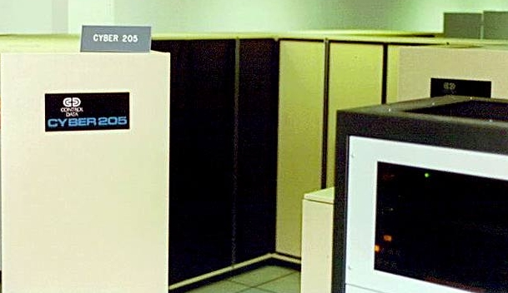
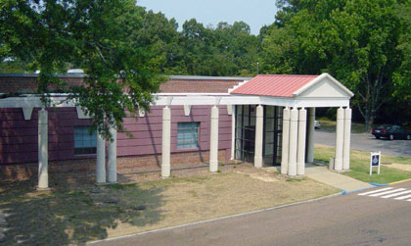
History
Established in 1987 by the
Mississippi Legislature
Standard Oil Donated
CDC Cyber 205
Construction of Combined UM/MCSR Data Center
Notes:
NSF Expiration Sep 30, 2004; HPVCI Expiration Date Dec 31, 2002.

Slide 4
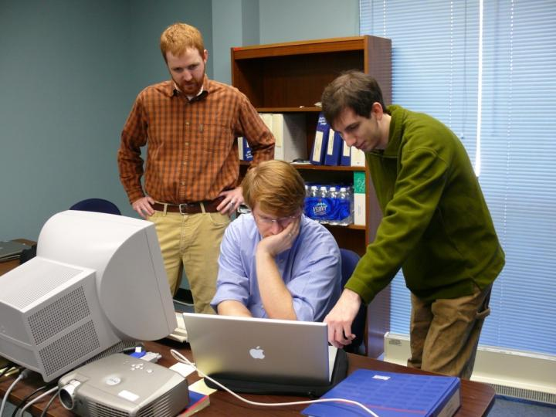
How Does MCSR Support Research?
Research Accounts on MCSR Supercomputers
Available to all researcher at MS universities
No cost to the researcher or the institution
Services
Consulting
Training
HPC Helpdesk
Notes:
NSF Expiration Sep 30, 2004; HPVCI Expiration Date Dec 31, 2002.

Slide 5

Why to Mississippi Researchers Need Supercomputers?
Economic$
Computational simulations:
allow researchers in states with limited resources to achieve national prominence & make a big impact in their field
& are:
- Faster
- Cheaper
- Less Dangerous
than trial and error alone.

Slide 6
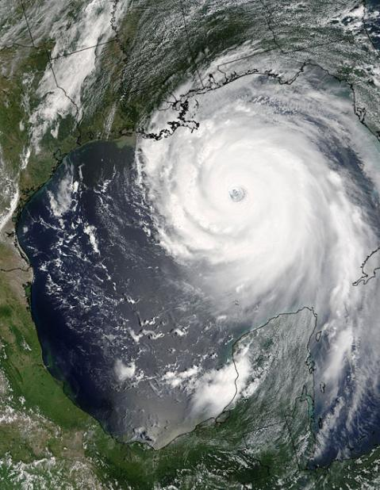


What Kinds Research @ MCSR?
Designing absorbents to safely clean up highly explosive materials
Designing materials to strengthen levees and ship hulls
Working out the underpinnings of high-powered lasers
Investigating proteins to create lifesaving drugs
Improving 3-D imaging to diagnose tumors
Developing polymers to prevent corrosion
Improving weather forecasting models
Designing more efficient rocket fuels

Slide 7
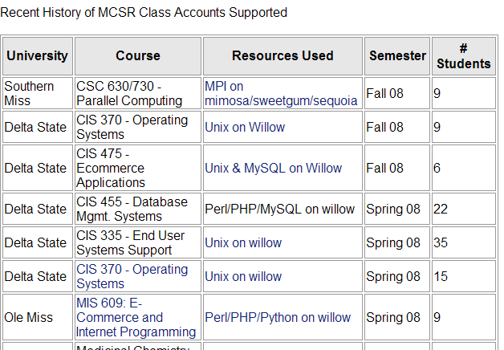
Education at MCSR
Over 87 University Courses Supported since 2000
C/C++, Fortran,
MPI, OpenMP,
MySQL, HTML,
Javascript,
Matlab, PHP,
Perl, ….
http://www.mcsr.olemiss.edu/education.php

Slide 8
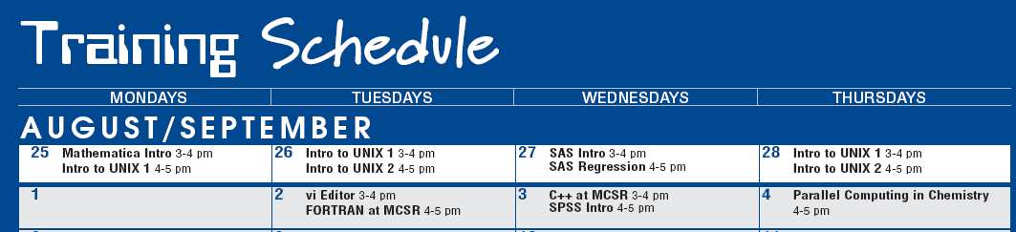
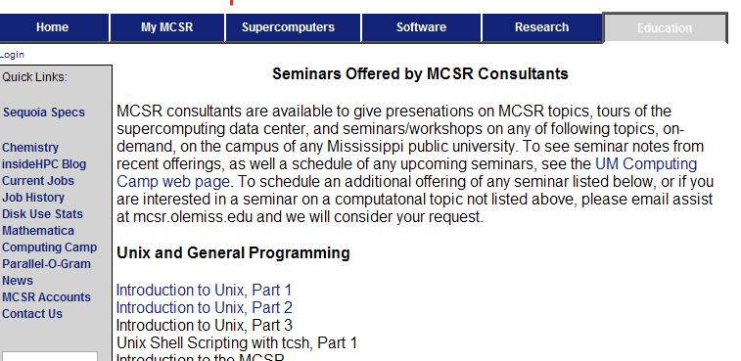
Training at MCSR
MCSR consultants taught over 140 free seminars in FY08.
Over 60 training topics available, and growing.
Fixed schedule or on-demand.
Unix/programming, Math Software, Stats Software, Computational Chemistry Software
Notes:
NSF Expiration Sep 30, 2004; HPVCI Expiration Date Dec 31, 2002.

Slide 9
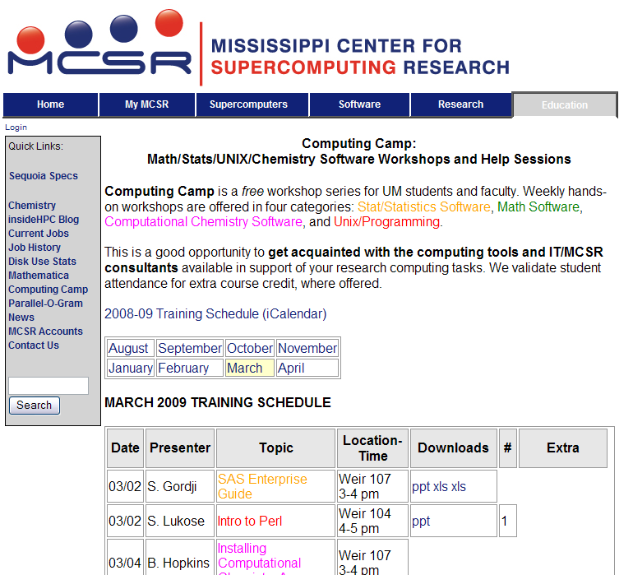

Slide 10

Software at MCSR
Programming
C/C++, FORTRAN, Java, Perl, PHP, MPI…
Science/Engineering
PV-Wave, IMSL, GSL, Math Libraries, Abaqus
Math/Statistics
SAS, SPSS, Matlab, Mathematica
Chemistry
Gaussian, Amber, NWChem, GAMESS,
CPMD, MPQC, GROMACS

Slide 11
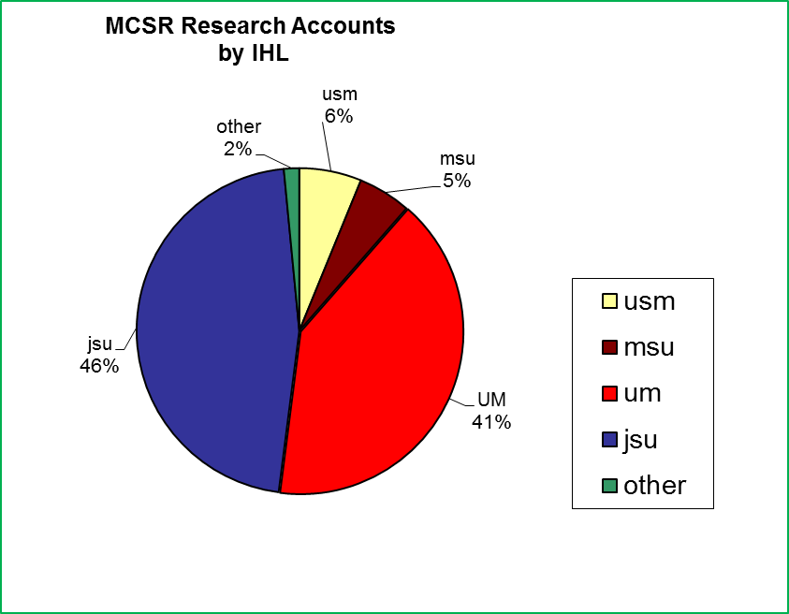
Who uses MCSR?

Slide 12
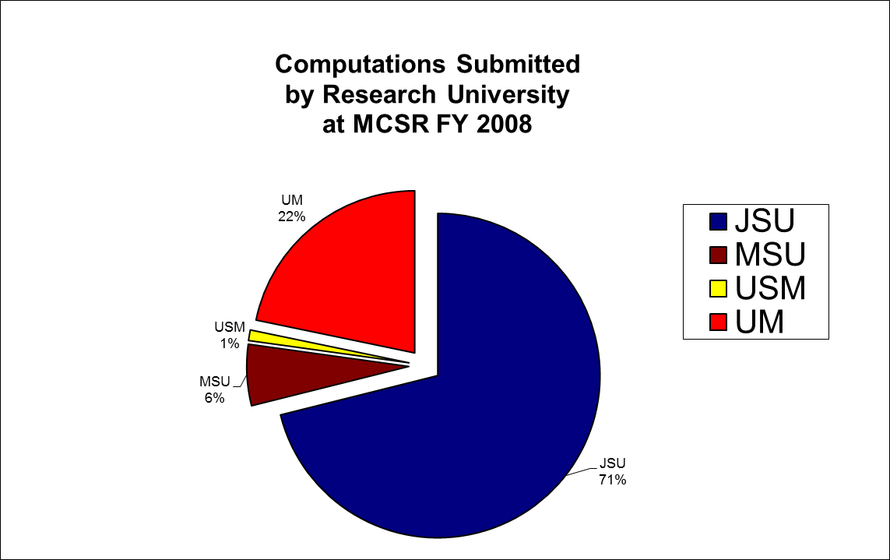
Who uses MCSR?

Slide 13
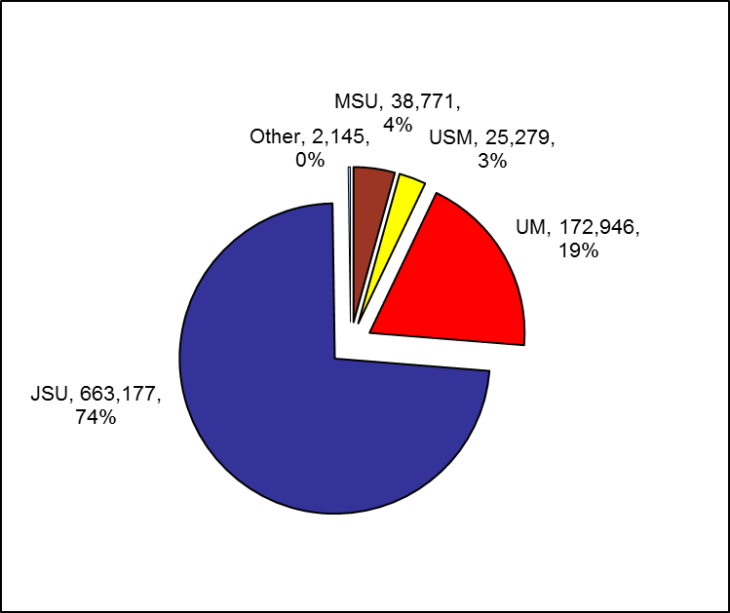
Who uses MCSR?
CPU Hours (1st QTR FY09)

Slide 14

What is a Supercomputer?
More computer you can handle on your desktop
more CPUs, Memory, and/or Disk
Notes:
NSF Expiration Sep 30, 2004; HPVCI Expiration Date Dec 31, 2002.

Slide 15
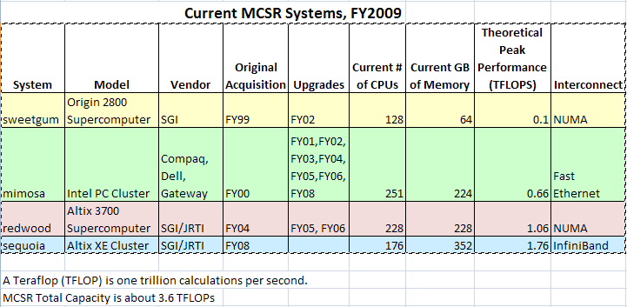
What Supercomputers @ MCSR?
Notes:
NSF Expiration Sep 30, 2004; HPVCI Expiration Date Dec 31, 2002.

Slide 16
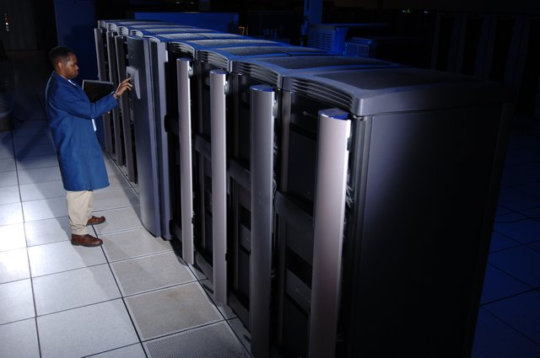
Supercomputers at MCSR: sweetgum
- SGI Origin 2800 128-CPU Supercomputer
- 64 GB of shared memory
Notes:
NSF Expiration Sep 30, 2004; HPVCI Expiration Date Dec 31, 2002.

Slide 17
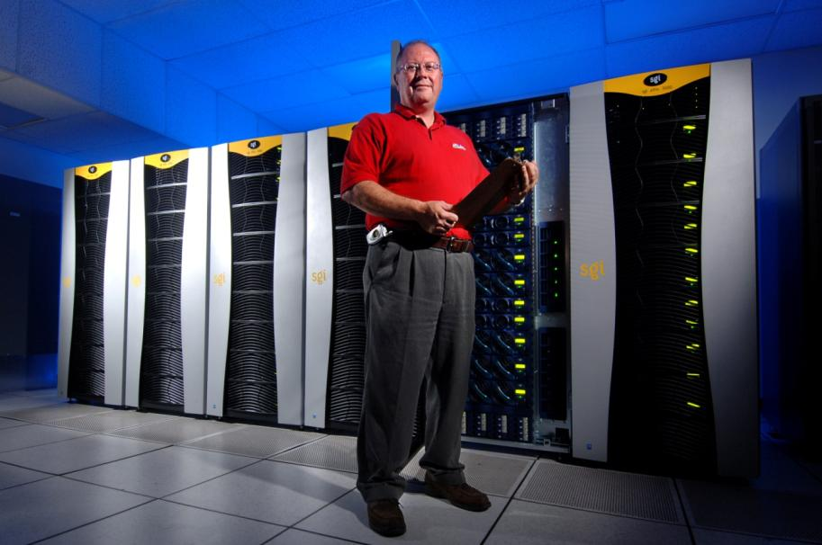
Supercomputers at MCSR: redwood
- 224 CPU SGI Altix 3700 Supercomputer
- 224 GB of shared memory
Notes:
NSF Expiration Sep 30, 2004; HPVCI Expiration Date Dec 31, 2002.

Slide 18
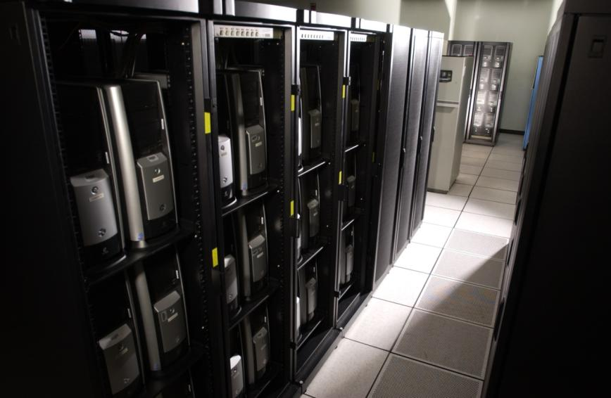
Supercomputers at MCSR: mimosa
253 CPU Intel Linux Cluster – Pentium 4
Distributed memory – 500MB – 1GB per node
Gigabit Ethernet
Notes:
NSF Expiration Sep 30, 2004; HPVCI Expiration Date Dec 31, 2002.

Slide 19
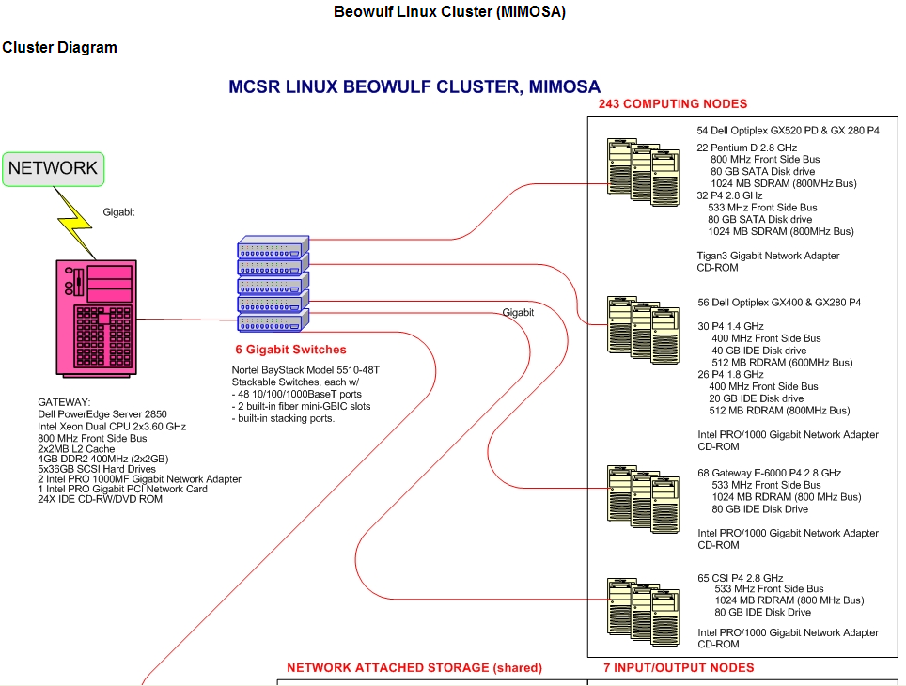

Slide 20
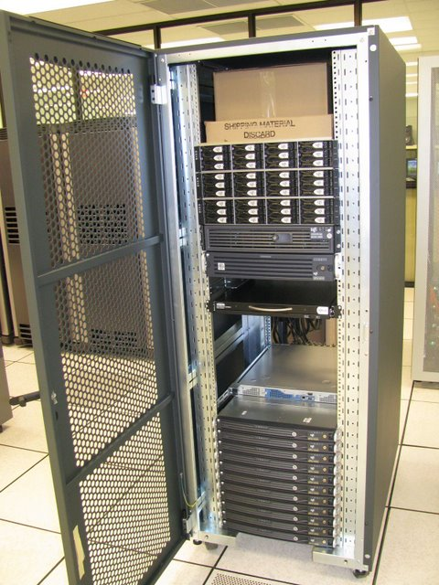
Supercomputers at MCSR: sequoia
22 nodes
176 cores
352 GB Memory
20 TB Storage
InfiniBand Interconnect
Notes:
NSF Expiration Sep 30, 2004; HPVCI Expiration Date Dec 31, 2002.

Slide 21
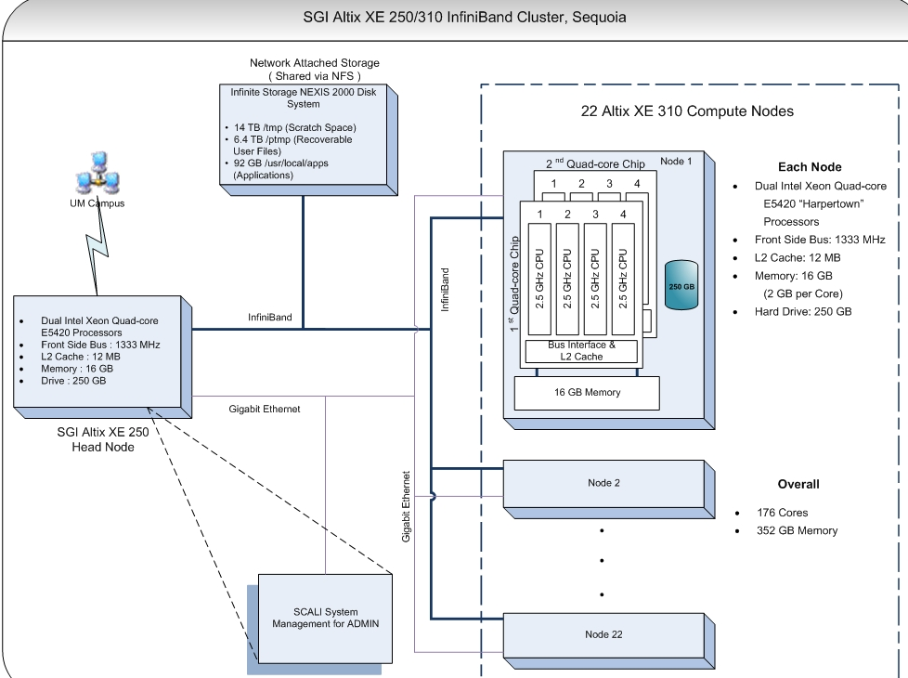

Slide 22
What is Parallel Computing?
  Using more than one computer (or processor) to complete a computational problem
  Theoretically, a computation can complete in 1/n^{th} time on n processors.
Notes:
NSF Expiration Sep 30, 2004; HPVCI Expiration Date Dec 31, 2002.

Slide 23
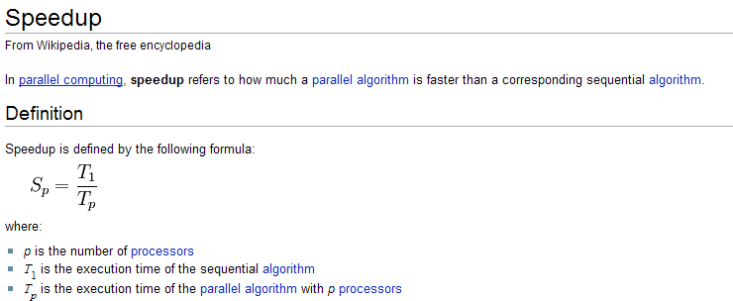
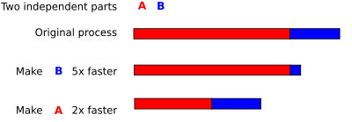

Speed-Up
  http://www.mcsr.olemiss.edu/Engr692_TimingWorshkeet.xls
Notes:
NSF Expiration Sep 30, 2004; HPVCI Expiration Date Dec 31, 2002.

Slide 24
Models of Parallel Computing
Message Passing Computing
  Processes coordinate and communicate results via calls to message passing library routines
  Programmers “parallelize” algorithm and add message calls
  At MCSR, this is via MPI programming with C or Fortran
    Sweetgum, Mimosa, Redwood, or Sequoia
Shared Memory Computing
  Processes or threads coordinate and communicate results via shared memory variables
  Care must be taken not to modify the wrong memory areas
  At MCSR, this is via OpenMP programming with C or Fortran on sweetgum, redwood, or sequoia (intra-node)
  Thread Safety
Notes:
NSF Expiration Sep 30, 2004; HPVCI Expiration Date Dec 31, 2002.

Slide 25
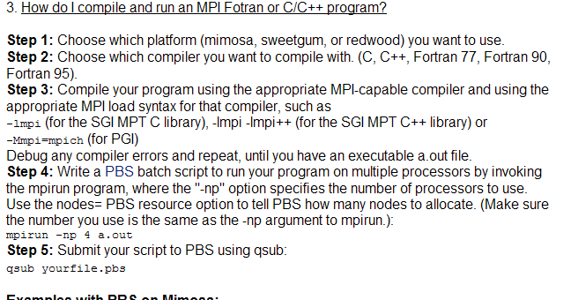
How to Compile & Run an MPI Program @ MCSR?
Notes:
NSF Expiration Sep 30, 2004; HPVCI Expiration Date Dec 31, 2002.

Slide 26
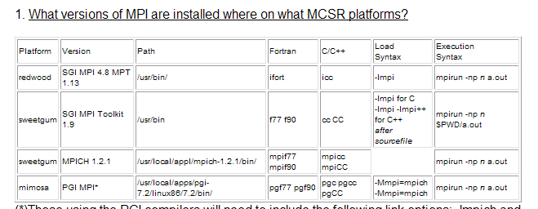
Message Passing Interface
MPI
Notes:
NSF Expiration Sep 30, 2004; HPVCI Expiration Date Dec 31, 2002.

Slide 27
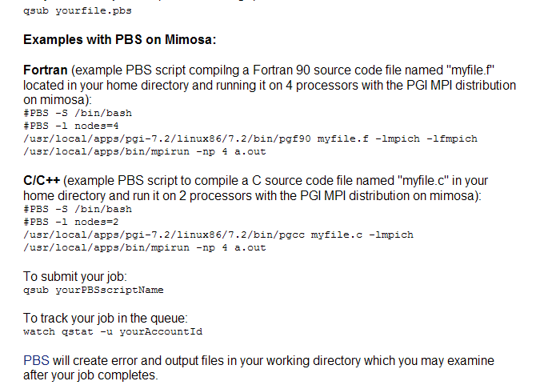

Slide 28
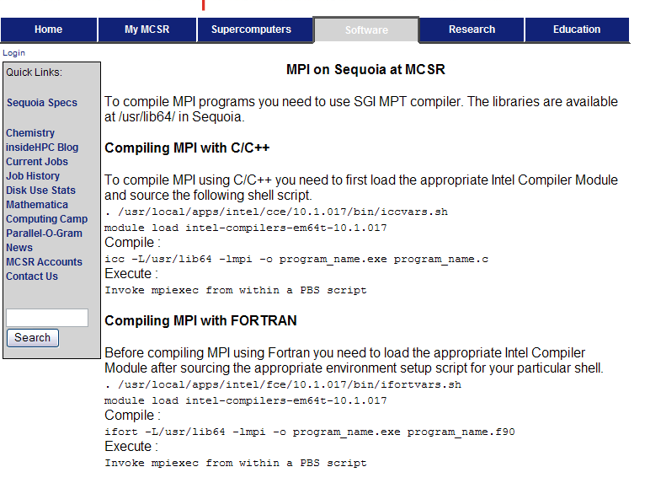
Notes:
NSF Expiration Sep 30, 2004; HPVCI Expiration Date Dec 31, 2002.

Slide 29
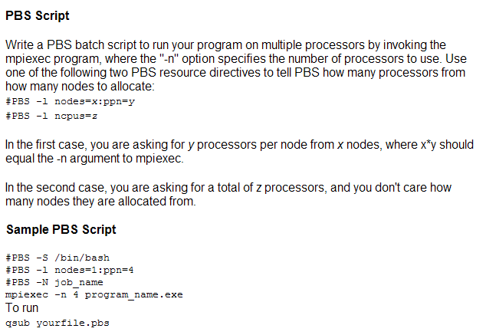
Example PBS Script: Sequoia
Notes:
NSF Expiration Sep 30, 2004; HPVCI Expiration Date Dec 31, 2002.

Slide 30
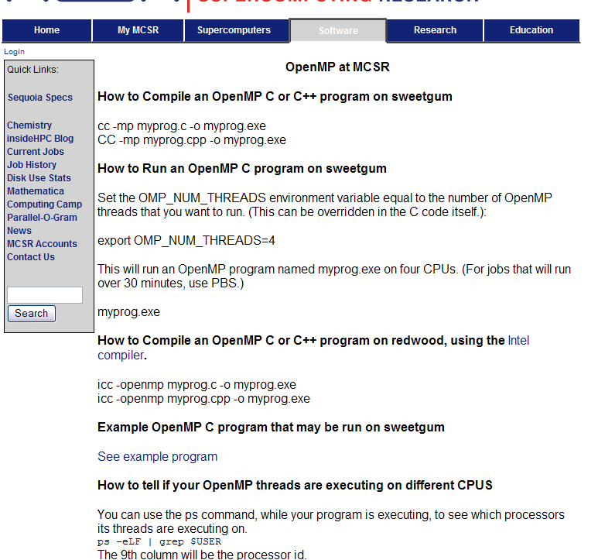
Notes:
NSF Expiration Sep 30, 2004; HPVCI Expiration Date Dec 31, 2002.

Slide 31
Message Passing Computing at MCSR
Process Creation
Slave and Master Processes
Static vs. Dynamic Work Allocation
Compilation
Models
Basics
Synchronous Message Passing
Collective Message Passing
Deadlocks
Examples
Notes:
NSF Expiration Sep 30, 2004; HPVCI Expiration Date Dec 31, 2002.

Slide 32
Message Passing Process Creation
Dynamic
  one process spawns other processes & gives them work
  PVM
  More flexible
  More overhead - process creation and cleanup
Static
  Total number of processes determined before execution begins
  MPI

Slide 33

Message Passing Processes
Often, one process will be the manager, and the remaining processes will be the workers
Each process has a unique rank/identifier
Each process runs in a separate memory space and has its own copy of variables

Slide 34
Message Passing Work Allocation
Manager Process
  Does initial sequential processing
  Initially distributes work among the workers
    Statically or Dynamically
  Collects the intermediate results from workers
  Combines into the final solution
Worker Process
  Receives work from, and returns results to, the manager
  May distribute work amongst themselves
  (decentralized load balancing)

Slide 35
Message Passing Compilation
Compile/link programs w/ message passing libraries using regular (sequential) compilers
Fortran MPI example:
include mpif.h
C MPI example:
    #include “mpi.h”
See MCSR Web for exact MCSR MPI directory locations

Slide 36
Message Passing Models
SPMD – Shared Program/Multiple Data
  Single version of the source code used for each process
  Master executes one portion of the program; slaves execute another; some portions executed by both
  Requires one compilation per architecture type
  MPI
MPMP – Multiple Program/Multiple Data
  Once source code for master; another for slave
  Each must be compiled separately
  PVM

Slide 37
Message Passing Basics
Each process must first establish the message passing environment
Fortran MPI example:
  integer ierror
  call MPI_INIT (ierror)
C MPI example:
int ierror;
ierror = MPI_Init(&argc, &argv);

Slide 38
Message Passing Basics
Each process has a rank, or id number
  0, 1, 2, … n-1, where there are n processes
With SPMD, each process must determine its own rank by calling a library routine
Fortran MPI Example:
integer comm, rank, ierror
call MPI_COMM_RANK(MPI_COMM_WORLD, rank, ierror)
C MPI Example
ierror = MPI_Comm_rank(MPI_COMM_WORLD, &rank);

Slide 39
Message Passing Basics
Each process has a rank, or id number
  0, 1, 2, … n-1, where there are n processes
Each process may use a library call to determine how many total processes it has to play with
Fortran MPI Example:
integer comm, size, ierror
call MPI_COMM_SIZE(MPI_COMM_WORLD, size, ierror)
C MPI Example
ierror = MPI_Comm_rank(MPI_COMM_WORLD, &size);

Slide 40
Message Passing Basics
Each process has a rank, or id number
  0, 1, 2, … n-1, where there are n processes
Once a process knows the size, it also knows the ranks (id #’s) of those other processes, and can send or receive a message to/from any other process.
Fortran MPI Example:
call MPI_SEND(buf, count, datatype, dest, tag, comm, ierror)
------DATA---------- ---EVELOPE--- -status------
call MPI_RECV(buf, count, datatype, sourc,tag,comm, status,ierror)

Slide 41
MPI Send and Receive Arguments
Buf starting location of data
Count number of elements
Datatype MPI_Integer, MPI_Real, MPI_Character…
Destination rank of process to whom msg being sent
Source rank of sender from whom msg being received
or MPI_ANY_SOURCE
Tag integer chosen by program to indicate type of message
or MPI_ANY_TAG
Communicator id’s the process team, e.g., MPI_COMM_WORLD
Status the result of the call (such as the # data items received)

Slide 42
Synchronous Message Passing
Message calls may be blocking or nonblocking
Blocking Send
  Waits to return until the message has been received by the destination process
  This synchronizes the sender with the receiver
Nonblocking Send
  Return is immediate, without regard for whether the message has been transferred to the receiver
  DANGER: Sender must not change the variable containing the old message before the transfer is done.
  MPI_ISend() is nonblocking

Slide 43
Synchronous Message Passing
Locally Blocking Send
  The message is copied from the send parameter variable to intermediate buffer in the calling process
  Returns as soon as the local copy is complete
  Does not wait for receiver to transfer the message from the buffer
  Does not synchronize
  The sender’s message variable may safely be reused immediately
  MPI_Send() is locally blocking

Slide 44
Sample Portable Batch System Script Sample
  mimosa% vi example.pbs
#!/bin/bash
  #PBS -l nodes=4 (MIMOSA)
  #PBS –l ncpus=4 (SWEETGUM)
  #PBS -q MCSR-4N
  #PBS –N example
  export PGI=/usr/local/apps/pgi-6.1
  export PATH=$PGI/linux86/6.1/bin:$PATH
  cd $PWD
  rm *.pbs.[eo]*
  pgcc –o add_mpi.exe add_mpi.c –lmpich
  mpirun -np 4 add_mpi.exe
  mimosa % qsub example.pbs
  37537.mimosa.mcsr.olemiss.edu
Notes:
NSF Expiration Sep 30, 2004; HPVCI Expiration Date Dec 31, 2002.

Slide 45
Sample Portable Batch System Script Sample
  Mimosa% qstat
  Job id Name User Time Use S Queue
  --------------- -------- --------- ----------- - -----------
  37521.mimosa 4_3.pbs r0829 01:05:17 R MCSR-2N
  37524.mimosa 2_4.pbs r0829 01:00:58 R MCSR-2N
  37525.mimosa GC8w.pbs lgorb 01:03:25 R MCSR-2N
  37526.mimosa 3_6.pbs r0829 01:01:54 R MCSR-2N
  37528.mimosa GCr8w.pbs lgorb 00:59:19 R MCSR-2N
  37530.mimosa ATr7w.pbs lgorb 00:55:29 R MCSR-2N
  37537.mimosa example tpirim 0 Q MCSR-16N
  37539.mimosa try1 cs49011 00:00:00 R MCSR-CA
  Further information about using PBS at MCSR: http://www.mcsr.olemiss.edu/appssubpage.php?pagename=pbs_1.inc&menu=vMBPBS.inc
Notes:
NSF Expiration Sep 30, 2004; HPVCI Expiration Date Dec 31, 2002.

Slide 46
For More Information
  Hello World MPI Examples on Sweetgum (/usr/local/appl/mpihello) and Mimosa (/usr/local/apps/ppro/mpiworkshop):
    http://www.mcsr.olemiss.edu/appssubpage.php?pagename=MPI_Ex1.inc
    http://www.mcsr.olemiss.edu/appssubpage.php?pagename=MPI_Ex2.inc
    http://www.mcsr.olemiss.edu/appssubpage.php?pagename=MPI_Ex3.inc
  Websites
    MPI at MCSR: http://www.mcsr.olemiss.edu/appssubpage.php?pagename=mpi.inc
    PBS at MCSR: http://www.mcsr.olemiss.edu/appssubpage.php?pagename=pbs_1.inc&menu=vMBPBS.inc
    Mimosa Cluster: http://www.mcsr.olemiss.edu/supercomputerssubpage.php?pagename=mimosa2.inc
    MCSR Accounts: http://www.mcsr.olemiss.edu/supercomputerssubpage.php?pagename=accounts.incThe
Notes:
NSF Expiration Sep 30, 2004; HPVCI Expiration Date Dec 31, 2002.

Slide 47
MPI Programming Exercises
  Hello World
  sequential
  parallel (w/MPI and PBS)
  Add and Array of numbers
  sequential
  parallel (w/MPI and PBS)
Notes:
NSF Expiration Sep 30, 2004; HPVCI Expiration Date Dec 31, 2002.

